Slide 1
Single Cell RNASeq Processing Pipeline: from Fastq to Counts Matrix
CSHL Single Cell Course
Bioinformatics Lecture 1
Emily Wheeler – Gene Yeo Lab
ecwheele@ucsd.edu

Slide 2
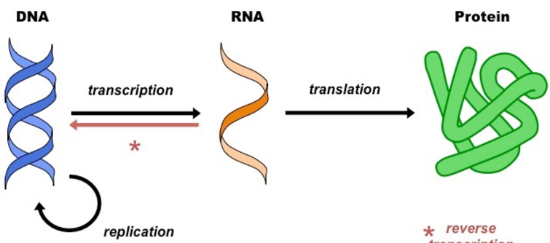
“Gene Expression”
No variability between cells
Difficult to Measure
Cell identity and Function

Slide 3
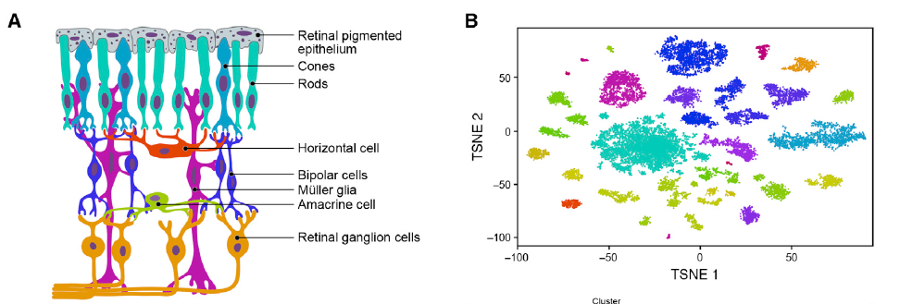
Complex Tissue
Define Cell States
Identify what cell types make up the population
Identify genes that are driving different cell states
Macosko et al. 2015 Cell
Notes:
Therefore using gene expression, we can identify cell types in a population and identify different genes that are driving those cell states

Slide 4
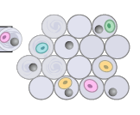
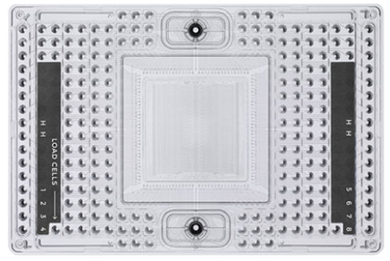
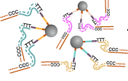
Step 1: Single Cell RNA Capture
Capture the transcriptome of each cell individually
Maintain a unique identity on sequences that come from the same cell
Capture
Independently
Capture and Prepare Library in Isolation (Fluidigm C1, SmartSeq2)
Prepare Library in Bulk
(Drop-Seq, Seq-Well)
Macosko et al. 2015 Cell
Notes:
Has anyone prepped a standard RNA-Seq library before? Has any one prepped single cell libraries before?
Each well has a unique set of sequencing adapters - DONE

Slide 5
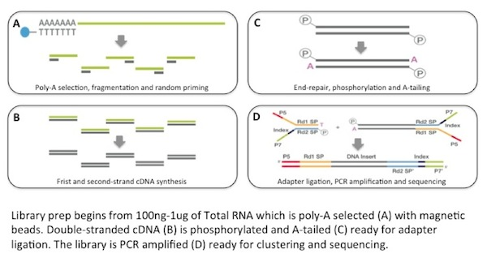
RNA-Seq library preparation workflow
How is this approach modified for single cell?
Illumina TruSeq library prep
Notes:
What’s the most abundant RNA in the cell? We don’t want to sequence just that

Slide 6
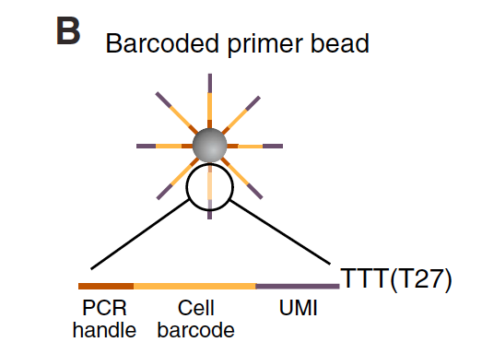
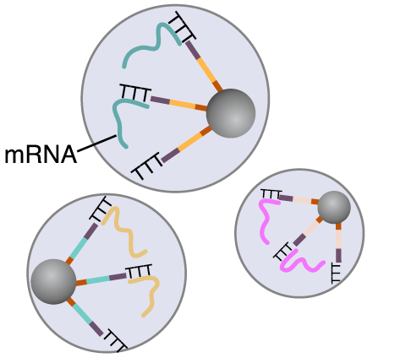
Preparing Libraries in Bulk Requires Barcoded Beads
TTTTTT
Tagmentation
TTTTTT
PCR amplification of 3’ end only
TTTTTT
Macosko et al. 2015 Cell
Notes:
Add a large aqueous volume post-hybridization to prevent hybridization after breaking the droplets
cDNA gets tagmented
Can anyone think of how we can get more information about full length transcripts? What technology do we need?
Different biases in different preparation methods can make it difficult to compare sequencing libraries

Slide 7
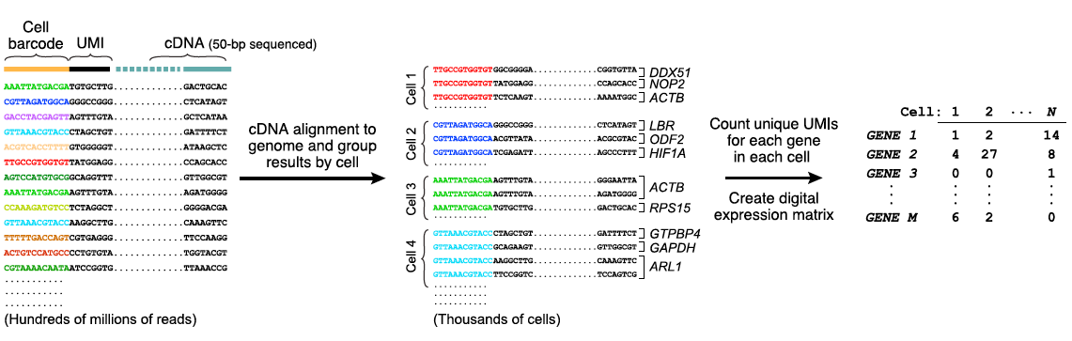

Unique Molecular Identifiers (UMI)
Unique Molecular Identifiers allow us to remove PCR duplicated reads
https://github.com/CGATOxford/UMI-tools

Slide 8
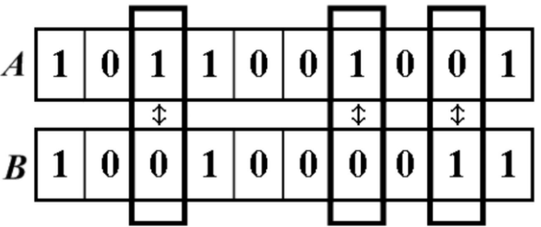
Hamming Distance – Correct Errors in UMIs
Hamming Distance – Number of positions that are different
Hamming Distance = 3
Cell Barcode Sequences
CCAGTTA
Hamming Distance = 1
Assign to the same cell ID
CCAGTAA

Slide 9
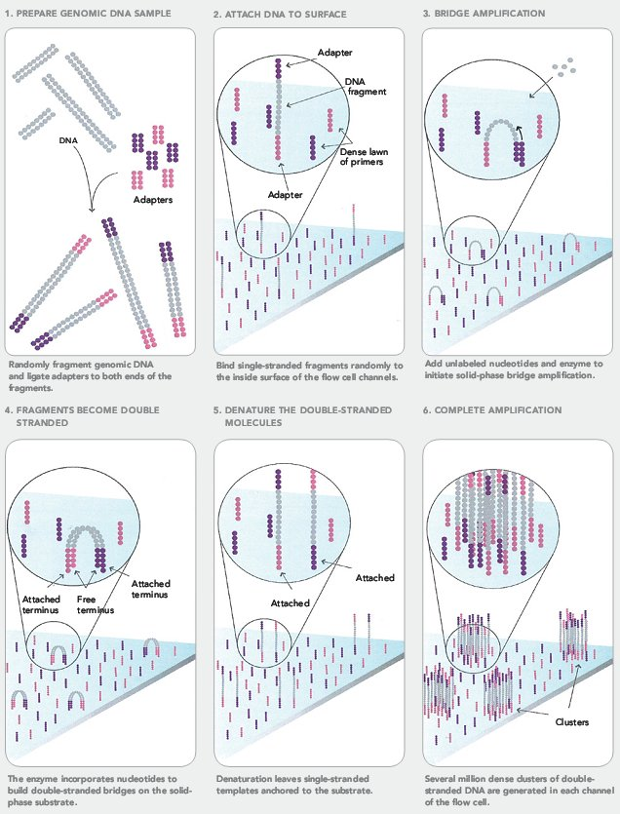
Illumina short read sequencing

Slide 10
Illumina short read sequencing
O
O
X
5’
HN
cleavage
site
HN
fluor
DNA
O
N
O
N
PPP
O
O
O
Incorporation
Detection
Deblock; fluor removal
3’
3’
block
OH
free 3’ end
Next cycle

Slide 11

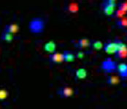







Illumina short read sequencing
T G C T A C G A T …
1
2
3
4
5
6
7
8
9
T T T T T T T G T …

Slide 12
Fastq file contains sequencing reads
Each fastq entry (sequencing read) contains 4 lines of information:
@Sequence Name
Nucleotide Sequence read from the machine
+ (sometimes followed by sequence name again)
Quality score read from the machine
@K00180:382:HJY7KBBXX:3:1101:25885:1015 2:N:0:NTTACTCG+NCCTCTAT
NGGCTTCACATCGTCCTGCGCGGAAGATGTAACGGGGCTAAGCCAGTTAC
+
#AAFFJJJJJJJJJJJJJJJJJJJJJJJJJJJJJJJJJJJJJJJJJJJFJ
Sequence of a single cDNA fragment from the RNA-Seq library
Notes:
What information do you need to figure out what read that gene came from?

Slide 13
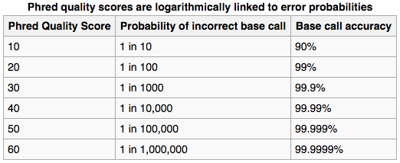
Quality Scores Filter out Incorrect Base Calls
Quality scores report the probability that the base call is incorrect
Field standard is to accept bases with quality >20
Notes:
What information do you need to figure out what read that gene came from?

Slide 14
Sequence Quality Decreases after ~300 bases
Quality score
0
100
200
300
400
Cycle #
Notes:
Can’t sequence longer than 300 - bad

Slide 15
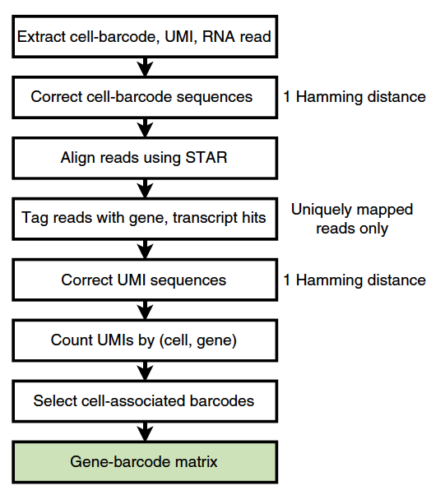

CellRanger Pipeline: Fastq to counts matrix
Zheng et al. 2017 Nature Comm.

Slide 16
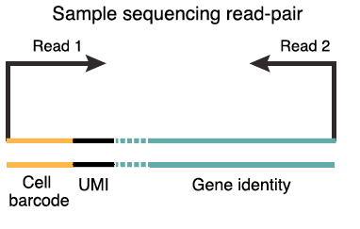
CellRanger Pipeline: Fastq to counts matrix
How do you determine the correct gene identity?
Macosko et al. 2015 Cell

Slide 17


What information is in a “reference genome”
Genome Sequence
Genome Annotation
https://genome.ucsc.edu/
https://www.gencodegenes.org/

Slide 18
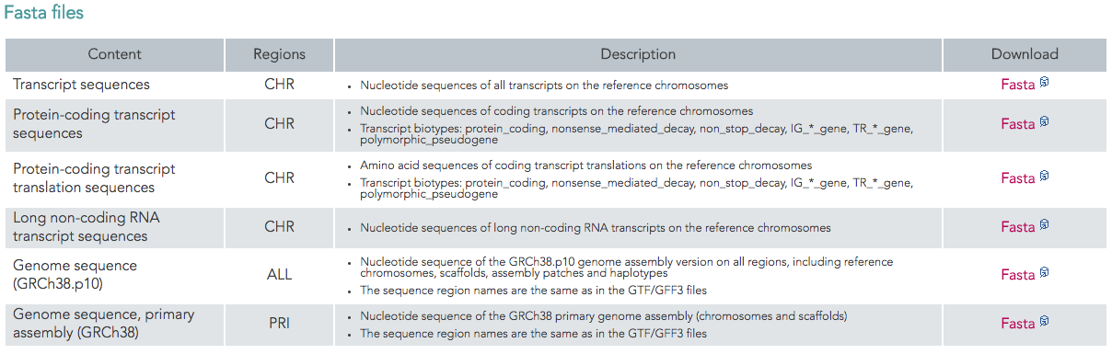
What information is in a “reference genome”
Genome Sequence
Nucleotide Sequence in the order it exists on chromosomes (fasta file)
>chr1
ATTACTGCCAGCCACCATGAATATTGTACGGTACCATAAATACTTGACCACCTGTAGTACATAAAAACCCAACCCACATCAAACCCCCCCCCCCC

Slide 19
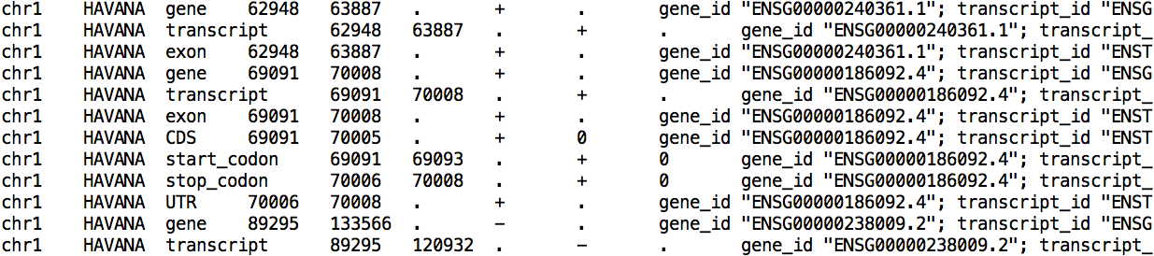
What information is in a “reference genome”
Genome Annotation (gtf or gff file)
Location where genes are located on the chromosomes
Describe features within genes (exons, introns, UTRs, alternatively spliced regions, start and stop codons, etc)

Slide 20
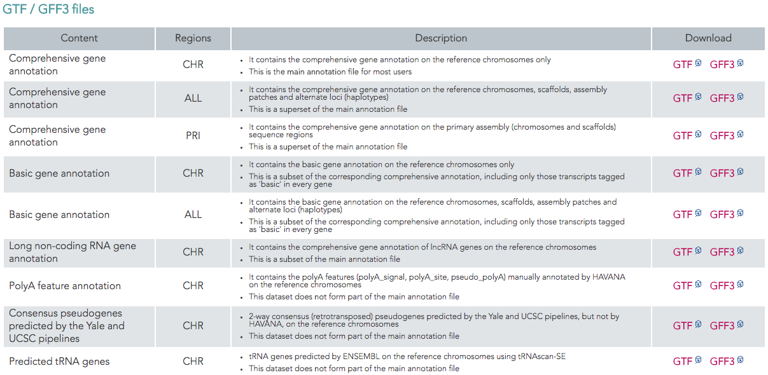
What information is in a “reference genome”
Genome Annotation (gtf or gff file)
Location where genes are located on the chromosomes
Describe features within genes (exons, introns, UTRs, alternatively spliced regions, start and stop codons, etc)

Slide 21
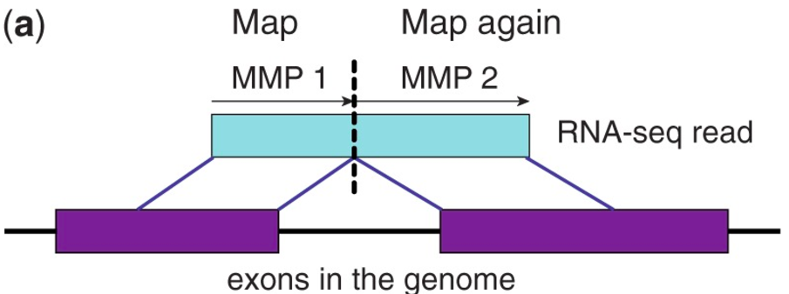
STAR – RNASeq aligner
Reads that map to more than one place in the genome
Nucleotides that map on each side of a spliced overhang
Maximum intron length for splice junctions
Translocation events – gene is expressed from 2 different chromosomes
User Manual: https://github.com/alexdobin/STAR/blob/master/doc/STARmanual.pdf
Dobin et al. 2013 Bioinformatics

Slide 22
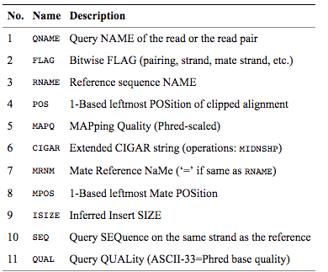
BAM file contains aligned reads
BAM files are binary, must use samtools to view them like this:
samtools view myfile.bam

Slide 23
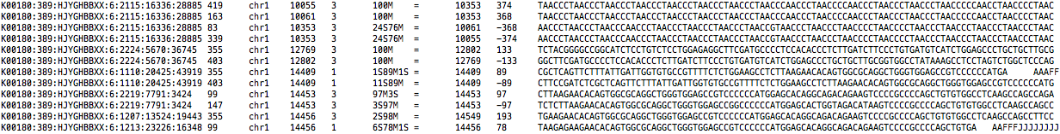
BAM file contains aligned reads
Many programs downstream of alignment read in BAM files
To quantify gene expression you can use featureCounts
http://bioinf.wehi.edu.au/featureCounts/

Slide 24
3’ end sequencing generates digital count matrix
Macosko et al. 2015 Cell

Slide 25
TPM vs FPKM (RPKM)
Purpose – Normalize for sequencing depth and gene length to allow comparison of counts between datasets and genes
FPKM – Fragments per Kilobase per Million Reads
(scale for sequencing depth, then scale for gene length):
Sum total # reads
Scale total by 10^6
Divide by total scaled # reads in library
Divide by length of the gene (kb)
TPM – Transcripts per Million Reads
(scale for gene length, then scale for sequencing depth):
Divide by length of the gene (kb)
Sum RPK values
Scale total by 10^6
Divide RPK by total

Slide 26
TPM vs FPKM
Gene name | Rep 1 read counts | Rep 2 read counts | Rep 3 read counts
A (2kb) | 10 | 12 | 30
B (4kb) | 20 | 25 | 60
C (1kb) | 5 | 8 | 15
D (10kb) | 0 | 0 | 1
TPM
FPKM
Gene name | Rep 1 TPM | Rep 2 TPM | Rep 3 TPM
A (2kb) | 333 | 296 | 333
B (4kb) | 333 | 309 | 333
C (1kb) | 333 | 395 | 333
D (10kb) | 0 | 0 | 2
SUM | 1000 | 1000 | 1000
Gene name | Rep 1 RPKM | Rep 2 RPKM | Rep 3 RPKM
A (2kb) | 143 | 133 | 142
B (4kb) | 143 | 139 | 142
C (1kb) | 143 | 178 | 142
D (10kb) | 0 | 0 | 1
SUM | 429 | 450 | 425
Macosko et al. 2015 Cell
Notes:
Key assumption – for longer genes you will sequence more genes. Is that true for single cell?

Slide 27
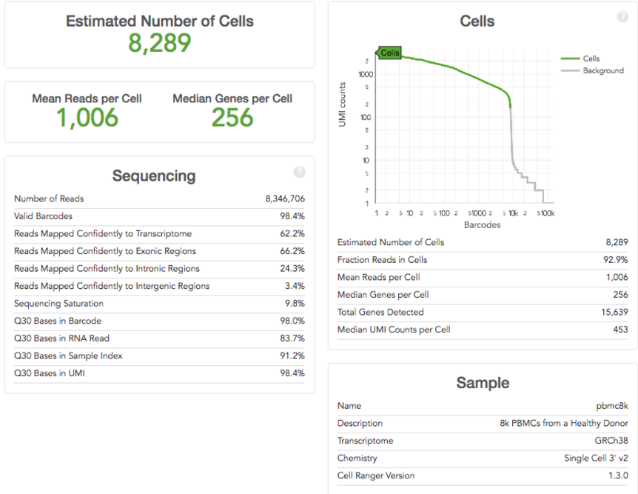
CellRanger Summary Page – QC metrics

Slide 28
Additional Resources
If you are NOT using 3’ end capture and an automated pipeline, here are some more resources to check out
Standard processing overview from last year’s single cell course:
https://github.com/YeoLab/single-cell-bioinformatics/blob/master/notebooks/1.1_Overview_of_analysis_steps.ipynb
RNA-Seq workflow (from Fastq to Differential Expression) from another (non single-cell) course:
https://github.com/biom262/biom262-2017/tree/master/Module1
NOTE –this involves a compute cluster, get help from your university for your own computing resources

